Slide 1

Planning Ideas Worth Stealing
- plus -
Samuel A. Donaldson
Georgia State University College of Law
Atlanta, Georgia

Slide 2

Our Agenda
Planning in Light of OB3 Developments
Charitable Contributions
Personal SALT Deduction Cap
Building an estate plan for married couples that withstands future changes in the tax laws
Other fun planning ideas
Charitable trusts as retirement plan beneficiaries
Maximizing the step-up in basis

Slide 3
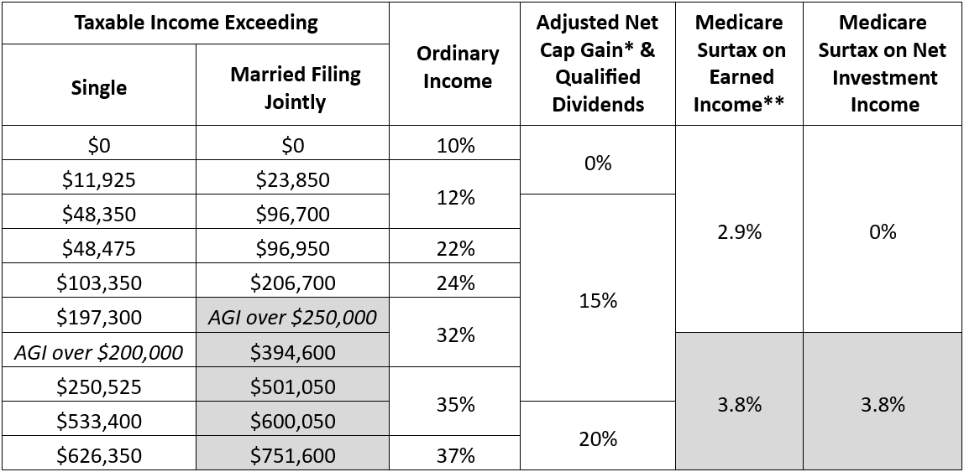
2025 Federal Income Tax Brackets for Individuals

Slide 4
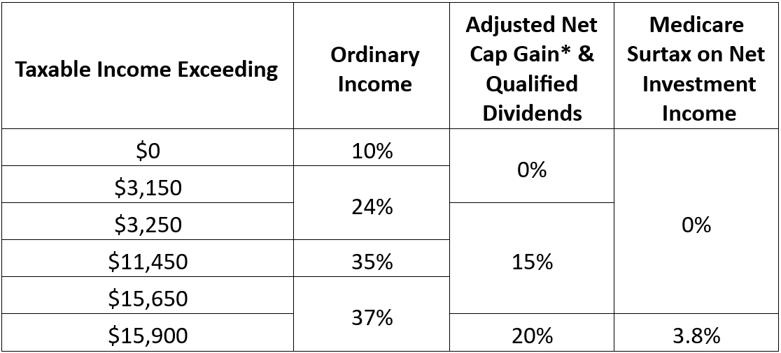
2025 Federal Income Tax Brackets for Trusts & Estates

Slide 5
Federal Wealth Transfer Tax Basic Exclusion Amount
Date of death | Basic exclusion amount
2011 | $5,000,000
2012 | $5,120,000
2013 | $5,250,000
2014 | $5,340,000
2015 | $5,430,000
2016 | $5,450,000
2017 | $5,490,000
2018 | $11,180,000
Date of death | Basic exclusion amount
2019 | $11,400,000
2020 | $11,580,000
2021 | $11,700,000
2022 | $12,060,000
2023 | $12,920,000
2024 | $13,610,000
2025 | $13,990,000
2026 | $15,000,000

Slide 6

Understanding the OB3 Act Charitable Contributions
Non-itemizers can deduct up to $1,000 in cash contributions starting in 2026 ($2,000 for joint filers)
Can still deduct cash contributions up to 60% of contribution base (adjusted gross income)
0.5% floor on donations by individuals, starting in 2026, with disallowed amounts carrying over up to 5 years

Slide 7

Understanding the OB3 Act Overall Limit on Itemized Deductions
New §68 starts in 2026
Reduces total itemized deductions by lesser of:
2/37 of total itemized deductions, or
2/37 of the amount by which (taxable income + total itemized deductions) exceeds 37% bracket threshold
Applies to individuals and trusts

Slide 8
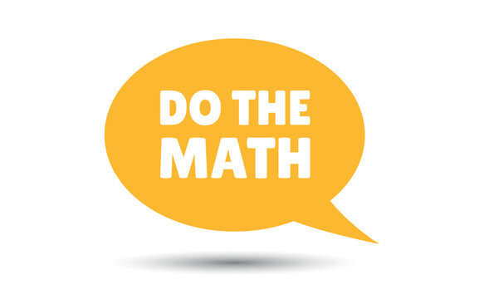
Understanding the OB3 Act Example of 2026 Charitable Contribution
T, an individual with a 2026 adjusted gross income of $1,000,000, donates $105,000 to charity. This is T’s only itemized deduction for 2026. Assume the 37% tax bracket for individuals in 2026 starts when taxable income exceeds $650,000.
Apply §170(b)(1)(I) 0.5% floor:
Contribution $105,000
0.5% of $1,000,000 contribution base ($5,000)
Deduction amount $100,000
Apply §68 overall limit on itemized deductions
Lesser of –
(1) 2/37 of $100,000 itemized deductions $5,405
or (2) 2/37 of $350,000 excess of AGI over $650,000 threshold vs. $18,519
Deduction thus reduced to $100,000 - $5,405 = $94,595 total deduction

Slide 9

There’s still a cap on the deduction for STATE AND LOCAL TAXES

Slide 10

Understanding the OB3 Act Deduction for Personal SALT
Deduction limit temporarily increased
Limit reduced by 30% of (AGI – “threshold amount”)
($10,000 minimum)
Year | Personal SALT Deduction Cap
2025 | $40,000
2026 | $40,400
2027 | $40,804
2028 | $41,212
2029 | $41,624
2030 and later | $10,000
Year | “Threshold Amount”
2025 | $500,000
2026 | $505,000
2027 | $510,050
2028 | $515,151
2029 | $520,302

Slide 11
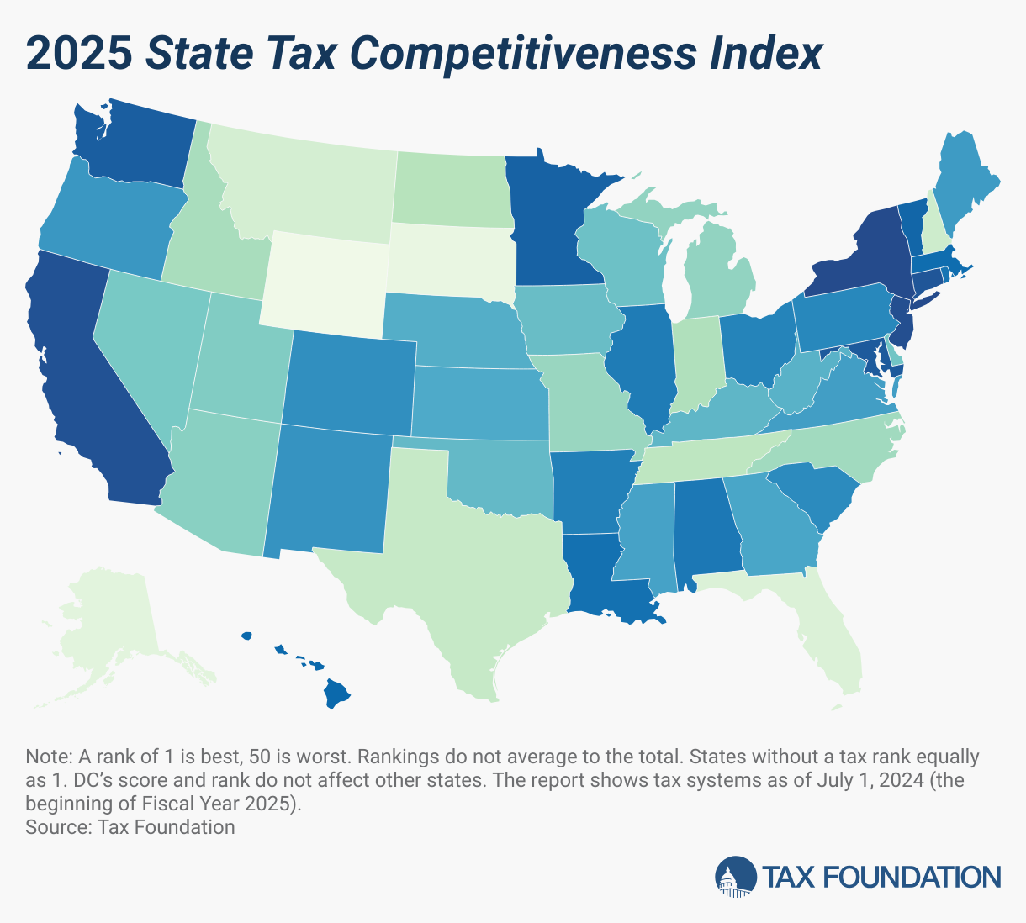
Planning for the SALT cap
45
5
9
43
44
6
41
2
50
Same cap for singles and MFJ
Applies only to personal taxes
Trusts may be helpful
Bunching tax payments
1
47
49
10
48
46
8
7
3
4
42

Slide 12



Estate Planning Templates for Married Couples

Slide 13
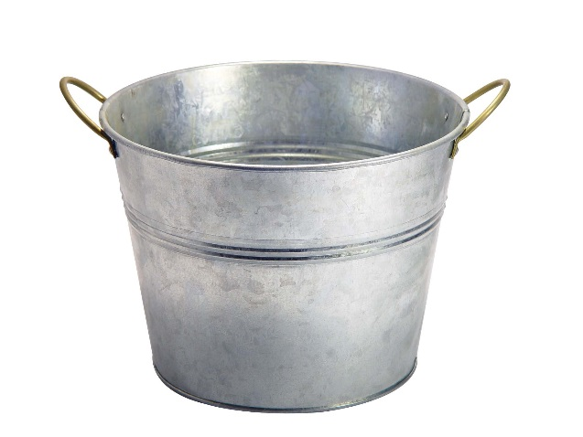
PLANNING PARADIGMS FOR MARRIED COUPLES
BUCKET ONE
Up to $15 million
BUCKET TWO
$15 - $30 million
BUCKET THREE
$30+ million

Slide 14
PLANNING PARADIGMS FOR MARRIED COUPLES
TRUST OR NO TRUST?
STEPPED-UP BASIS FOR EVERYTHING
Outright gift / Fully revocable trust
Trust with general power of appointment
QTIP trust
PROTECTIVE PORTABILITY ELECTION
BUCKET ONE
Up to $15 million

Slide 15
PLANNING PARADIGMS FOR MARRIED COUPLES
TRUST OR NO TRUST?
If NO TRUST (outright gift)
All to surviving spouse
Disclaimed amounts pass to credit shelter trust
If TRUST
Clayton QTIP
Unelected amounts pour into credit shelter trust
BUCKET TWO
$15- $30 million

Slide 16
PLANNING PARADIGMS FOR MARRIED COUPLES
KEEP CALM AND CARRY ON
Charitable planning
Life insurance planning
Sale transaction planning
SPOUSAL LIFETIME ACCESS TRUST?
BUCKET THREE
$30+ million

Slide 17
Spousal Lifetime Access Trusts (SLATs)
Donor Spouse (DS) creates irrevocable trust for benefit of Beneficiary Spouse (BS) and others
Structured like a “credit shelter trust” or “exemption trust” or “bypass trust”
Gift to the SLAT does not qualify for the marital deduction, so it uses up the DS’s exclusion
Usually structured as a grantor trust for income tax purposes
No estate tax upon BS’s death
BS can have testamentary limited power of appointment

Slide 18
Spousal Lifetime Access Trusts (SLATs)
Once transferred, assets don’t return to DS (but BS is free to share distributions voluntarily)
BS gets distributions for health, education, maintenance, and support – not whim
Upon divorce, BS’s interest continues unless “spouse” is defined generically (or divorce serves as termination event)
If each spouse wants to create SLAT for the other, need to avoid reciprocal trust doctrine
No stepped-up basis at either spouse’s death

Slide 19

Other Ideas for Planning in the Current Climate
Charitable remainder trusts for retirement plans
Maximizing the “step up” in basis

Slide 20

Charitable Remainder Trusts for Retirement Plans

Slide 21
Replaced life expectancy payout with 10-year payout for all EXCEPT for “eligible designated beneficiaries”
Surviving spouse
Participant’s minor child
Disabled beneficiary
Chronically ill beneficiary
Beneficiary less than 10 years younger than participant
The Original:
Setting
Every
Community
Up for
Retirement
Enhancement
Act

Slide 22
Charitable Remainder Trusts for Retirement Plans
Name a CRT as the beneficiary of an IRA or qualified plan
Pays annuity to individual beneficiary for life
Remainder to charitable organization
Although a 5-year payout period applies, the CRT is tax-exempt
Income will be taxed to individual beneficiary as payments are made
Thus resembles a lifetime stretch-out!

Slide 23

Ideas for Maximizing Stepped-Up Basis
Exercise of grantor trust swap power near death
Give trust beneficiaries narrow general power of appointment
Upstream sales
Establish trust in community property state

Slide 24


